Slide 1

Satellites over the world
Data mining
Machine learning
Omer Cohen
Shaked Gal
Matan Zarchi
GitHub

Slide 2

Research questions
.1 Can we predict the time it takes for a satellite to orbit the Earth by a given Perigee(the point of lowest altitude) ?
2. Can we predict the satellite's type of Orbit by a given Perigee and Apogee (the point of highest altitude) ?
3. Do satellites with different designations have common characteristics?

Slide 3

Information Sources:
Wikipedia
N2YO

Slide 4

CRAWLING
- First we saved the main countries and organizations code in order to concatenate each one with the satellite URL.
- We noticed that the URL pages with the satellite information change according to the 'Norad ID' of the satellite, so we crawled and saved the 'Norad ID' of all the satellites into a list.
- Finally we used the list to crawl all the data into a DataFrame.

Slide 5
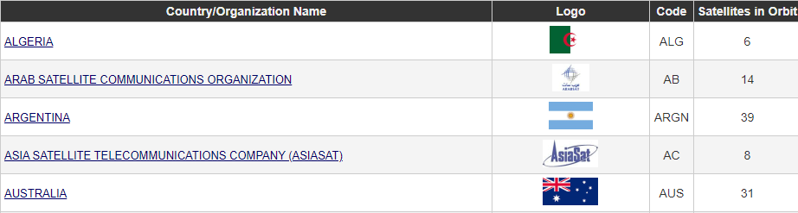
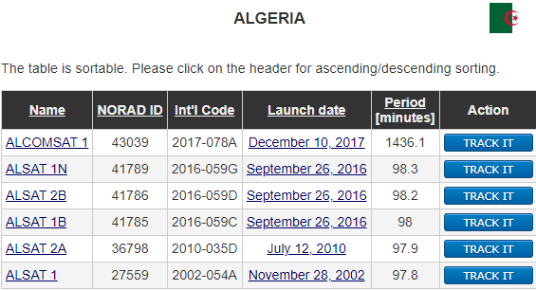

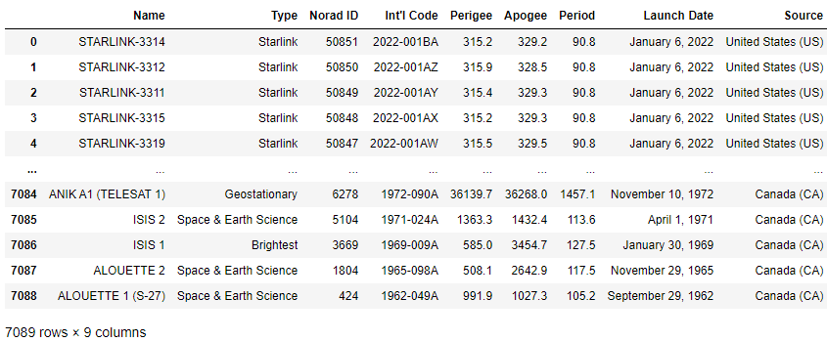
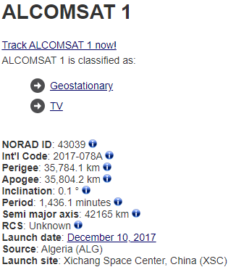

Slide 6

Data Cleaning

Slide 7
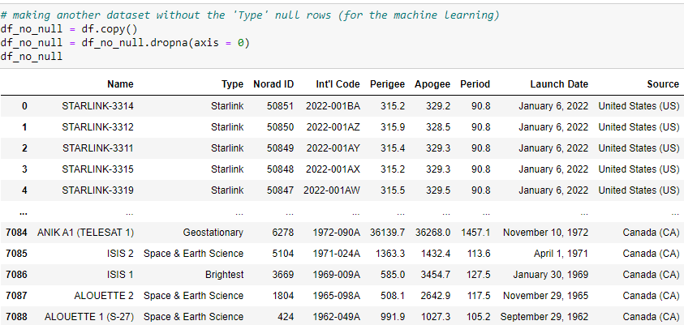
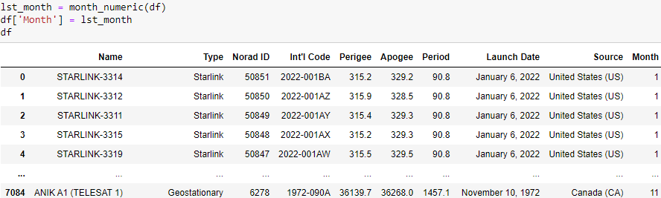
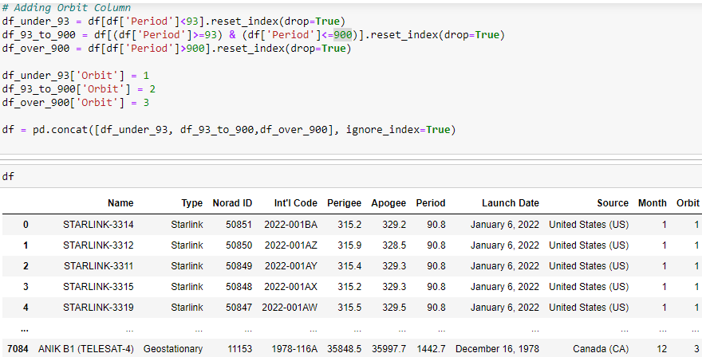
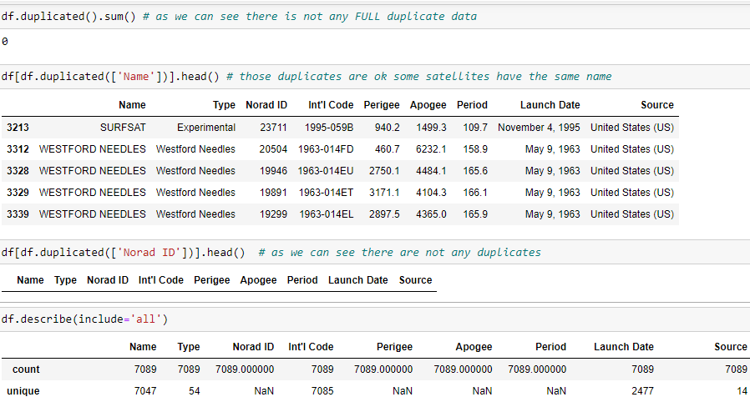
- Locating Missing Data and handling them - Adding 'Month' column:
f
- Locating Duplicate and outliers data - Adding 'Orbit' column:
=> We did not have any.

Slide 8

Visualizations

Slide 9
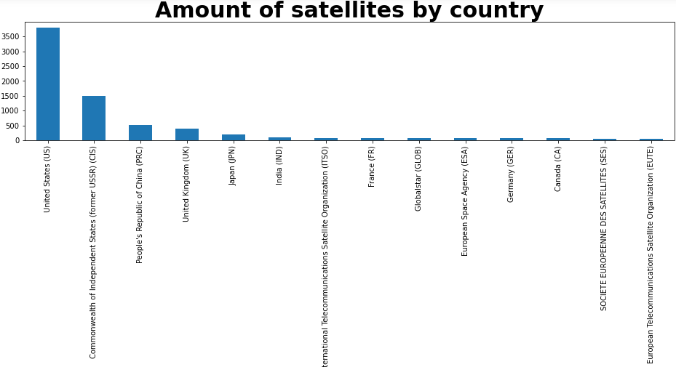
This graph shows the amount of satellites that each of the 9 countries that appear in a space-based dataframe. Some of the satellites are military satellites, communications, navigation, etc. There are a total of 53 types of satellites in our dataframe.

Slide 10
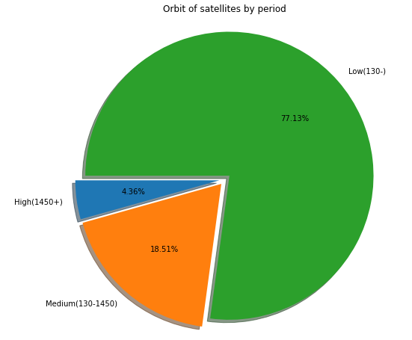
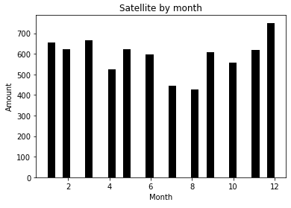
Period -> The period of a satellite is the time it takes it to make one full orbit around an object.
Orbit -> An orbit is a regular, repeating path that one object in space takes around another one.
Apogee -> The point of highest altitude is called apogee.
Perigee -> The point of lowest altitude is called perigee.

Slide 11
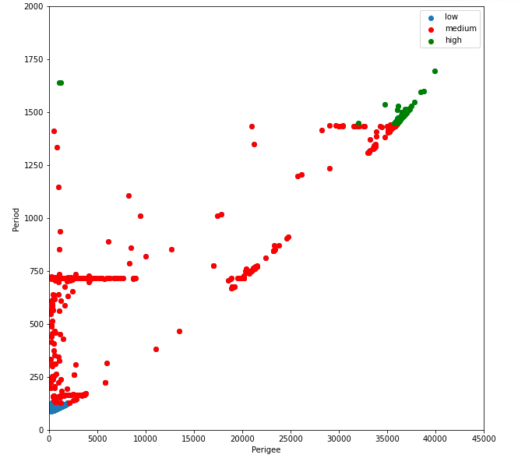
Scatterplot - here we showed the relation between the Perigee and the Period. The lower the Perigee, the closer the satellite is to the object around which it is moving, and therefore the force of gravity is greater, and in any case the period is shorter because the satellite's speed is higher. And vice versa, the larger the period, the greater the period.
Low, medium, high- 3 of orbit types.

Slide 12

Machine Learning

Slide 13
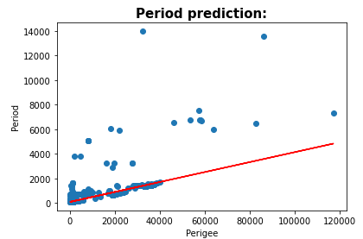


- We did a linear regression that predict the Period of a satellite by his Perigee. - The graph shows how close is the Period prediction.
Linear Regression

Slide 14
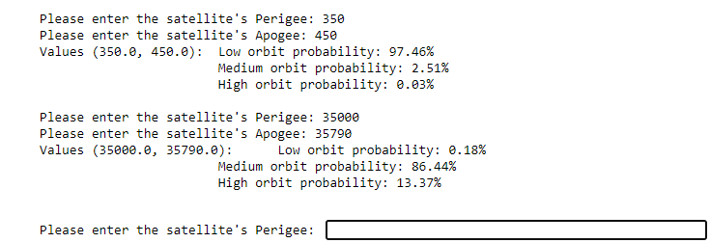
Logistic Regression 1
- We did a logistic regression which predicts the satellite's Orbit with a given Perigee and Apogee.
- The result shows the probability of each Orbit.

Slide 15
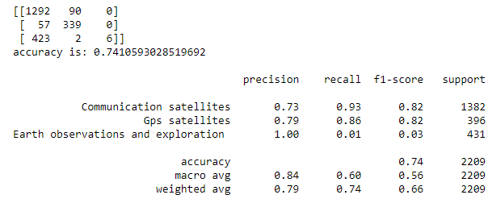
Logistic Regression 2
- We did another Logistic Regression which check our type classification by training the dataset and predict our label (Type):

Slide 16

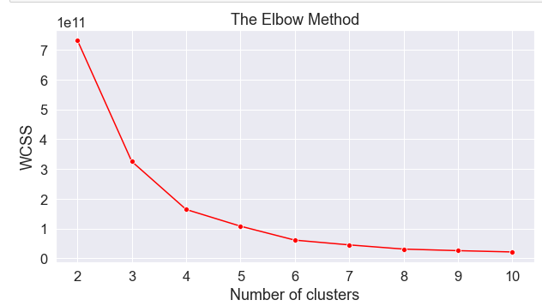
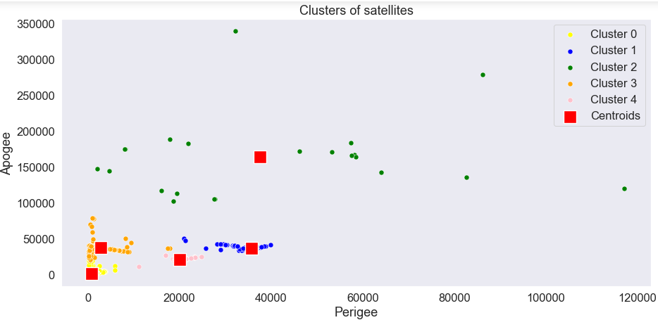
Unsupervised Learning
- We wanted to test whether there are common features between satellites whose designation is different from each other. That's why we used "K-Means":

Slide 17
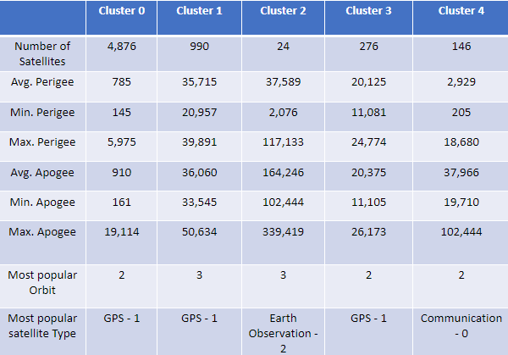

Attributes of k-mean’s clusters:

Slide 18
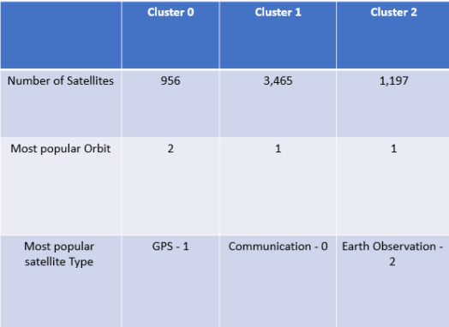

Changes due to applying k-mean’s to Type and Orbit only:
Most popular Orbit is now 1 – before it was 2 , Which means prediction of different Orbits
Most popular Type is now 0 – before it was 1 , Which means prediction of different Type’s
WOW
EFFECT

Slide 19

END...

